Slide 1
Prevention and health inequalities
Imperial Health Charity and Redthread
Youth Violence Intervention Programme A&E, St Mary’s Hospital

Slide 2
The problem …
In 2017, approx. 450 young people attended St Mary’s A&E as victims of violence – over 300 had been stabbed
Skilled medics are fully equipped to treat victims and save lives
But they lack the time and resources to address the community and psychological factors that lead to young people becoming involved in violence
Staff feel exasperated and demoralised when the same faces turn up at A&E time and again.

Slide 3
“[These] patients require so much more time than we can offer in ED. Also, ED is not a very conducive environment in which to explore such sensitive and emotional subjects. Added to that, the immaturity of the person involved makes these patients so very complex and vulnerable.”
A&E staff member, St Mary’s Hospital

Slide 4
A solution …
Funded by Imperial Health Charity, Redthread’s specialist youth workers are embedded within A&E and meet young victims
Aim to build trust and rapport, using the ‘teachable moment’ as an opportunity for reflection and positive change
Assess risks, create safety plans and begin one-to-one work in the community
Help to ensure young people do not simply leave hospital and return to unsafe, unstable and chaotic environments.

Slide 5
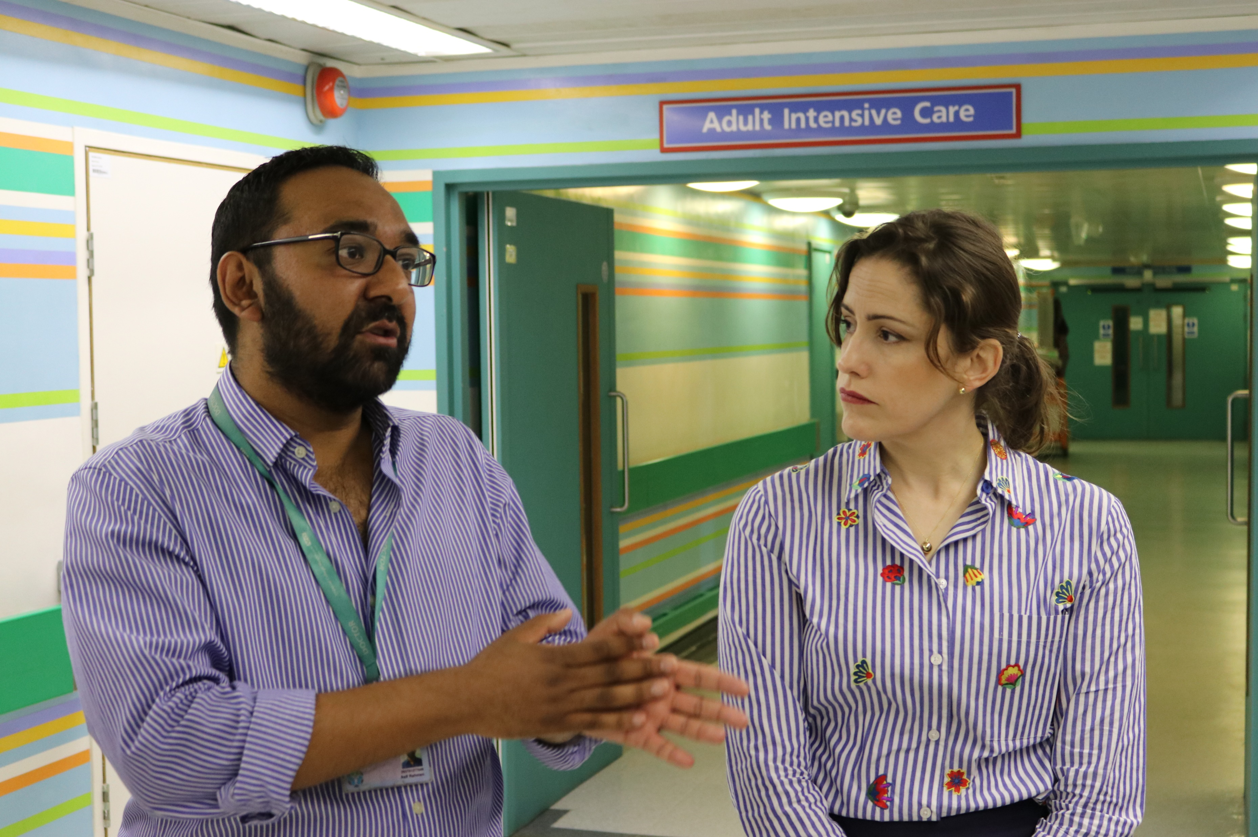
Home Office Minister Victoria Atkins MP with Dr Asif Rahman at
St Mary’s Hospital in 2018

Slide 6
Working in partnership since 2014
Partnership utilises the charity’s close working relationship with St Mary’s and Redthread’s expert knowledge in adolescence and community violence
Encourages collaboration between multiple healthcare providers within the hospital and wider community
Aiming to put in place structures of support that reduce pressure on hospital services
Able to identify and respond more effectively to individuals’ unique needs.

